Slide 1
Other Media Frameworks in iOS

Slide 2
Audio Toolbox: System Sounds
Provides a C interface for playing short sounds and for invoking vibration on iOS
Does not provide interface for:
Level, panning, looping, timing control, or simultaneous playback
System sounds already exist in the iOS device (no need to add to your resource bundle)
/System/Library/Audio/UISounds/
Typically used to provide alerts or notifications

Slide 3
Audio Toolbox: System Sounds
Inside Audio Toolbox is a function: AudioServicesPlaySystemSound
It takes only one argument: SystemSoundID
Playing a system sound is easy
#import <AudioToolBox/AudioToolbox.h>
AudioServicesPlaySystemSound(1007);
This plays the ‘SMS Received Alert’
Other System Sound IDs:
http://iphonedevwiki.net/index.php/AudioServices

Slide 4
Audio Toolbox: System Sounds
Custom System Sounds can be added by type-casting as a SystemSoundID
(In this case, you do need to include in your resource bundle)
First, create the URL to your sound file
NSString *soundPath = [[NSBundle mainBundle] pathForResource:@”sound" ofType:@”wav” inDirectory:@"/"];
CFURLRef SoundPathPathURL = (CFURLRef) [[NSURL alloc] initFileURLWithPath: soundPath];
Next, convert to a SystemSoundID and play
SystemSoundID systemSound;
AudioServicesCreateSystemSoundID(SoundPathPathURL ,&systemSound);
AudioServicesPlaySystemSound(systemSound);

Slide 5
Audio Toolbox: System Sounds
Other limitations
No longer than 30 s
Linear PCM format only
Packaged as a .caf .aif or .wav
Reference manual:
https://developer.apple.com/library/ios/documentation/AudioToolbox/Reference/SystemSoundServicesReference/

Slide 6
Media Player
Framework for playing:
movies, music, audio podcasts, and audio books
Provides access to the user’s iTunes Library (read-only)
Gives an interface to manipulate:
System volume, selecting output routes (including AirPlay streaming)

Slide 7
Media Player Picker
MPMediaPickerController is a subclass of UIViewController
Adds ability to provide a GUI for media selection
Is presented modally on an existing ViewController
To respond to user selections, conform to MPPickerControllerDelegate
Returns a Collection of MPMediaItems
A single piece of media (e.g., song, or video, or podcast)
Each media has a UUID (universal unique identifier) that persists across App launches
Meta data can be queried with valueForProperty

Slide 8
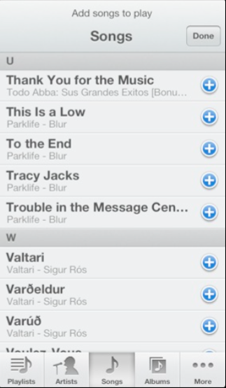
Media Player Picker

Slide 9
Media Player Picker
Creating a modal presentation of a Media Picker
First, add the Media Player Framework
#import <MediaPlayer/MediaPlayer.h>
Next, create the Picker
MPMediaPickerController *picker =[[MPMediaPickerController alloc] initWithMediaTypes: MPMediaTypeMusic];
picker.delegate = self; //MPMediaPickerControllerDelegate
picker.allowsPickingMultipleItems = YES;
picker.prompt = @“Choose music to play";

Slide 10
Media Player Picker
A Quick Note on Media Types
// audio media types
MPMediaTypeMusic
MPMediaTypePodcast
MPMediaTypeAudioBook
MPMediaTypeAudioITunesU
MPMediaTypeAnyAudio
// video media types
MPMediaTypeMovie
MPMediaTypeTVShow
MPMediaTypeVideoPodcast
MPMediaTypeMusicVideo
MPMediaTypeVideoITunesU
MPMediaTypeAnyVideo
// generic media type
MPMediaTypeAny

Slide 11
Media Player Picker
Creating a modal presentation of a Media Picker
Present the Picker in a modal View Controller
UINavigationController *pickerNavController = [[UINavigationController alloc] initWithRootViewController:picker];
[self presentViewController:pickerNavController animated: YES completion:nil];
Finally, respond to delegate callbacks
-(void)mediaPicker:(MPMediaPickerController*)mediaPicker didPickMediaItems:(MPMediaItemCollection*) mediaCollection
{ ...
// tell Media Player to add mediaCollection to the queue
...
}

Slide 12
MP Music Player
MPMusicPlayerController can play media items from the device library
Two basic types of Players:
Application music player: plays locally within your App and is agnostic to the System’s Music player state
System Music Player: built-in Music player in iOS; continues to play with your App in the background
Basic functionality of either type of player:
Create a shared instance of a player
Setup a playback queue
Super basic transport (repeat, loop, shuffle, skip)

Slide 13
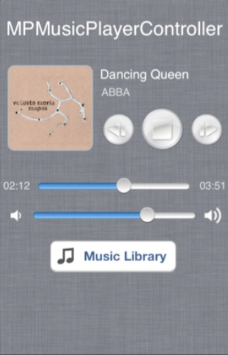
MP Music Player
Artwork
Meta data
Basic transport
System volume

Slide 14
Media Player Picker
Creating an MP Music Player
Play music through a system or application player
MPMusicPlayerController *myPlayer =[MPMusicPlayerController systemMusicPlayer ];
// OR...
MPMusicPlayerController *myPlayer =[MPMusicPlayerController applicationMusicPlayer ];
[myPlayer setQueueWithItemCollection: mediaCollection];
[myPlayer play];

Slide 15
Media Player Picker
Creating an MP Music Player
Query for meta data
// get track
MPMediaItem *myTrack = [myPlayer nowPlayingItem];
// get song title
NSString *title=[myTrack valueForProperty: MPMediaItemPropertyTitle]];
// get artist
NSString *artist=[myTrack valueForProperty: MPMediaItemPropertyArtist]];
// Creates and returns a UIImage object of a specified size
UIImage *artworkImage= [[myTrack valueForProperty: MPMediaItemPropertyArtwork]
imageWithSize: CGSizeMake (120, 120) ];

Slide 16
Media Item Property Keys
NSString *const MPMediaItemPropertyMediaType ;
NSString *const MPMediaItemPropertyTitle ;
NSString *const MPMediaItemPropertyAlbumTitle ;
NSString *const MPMediaItemPropertyArtist ;
NSString *const MPMediaItemPropertyAlbumArtist ;
NSString *const MPMediaItemPropertyGenre ;
NSString *const MPMediaItemPropertyComposer ;
NSString *const MPMediaItemPropertyPlaybackDuration;
NSString *const MPMediaItemPropertyAlbumTrackNumber;
NSString *const MPMediaItemPropertyAlbumTrackCount;
NSString *const MPMediaItemPropertyDiscNumber;
NSString *const MPMediaItemPropertyDiscCount;
NSString *const MPMediaItemPropertyArtwork;
NSString *const MPMediaItemPropertyLyrics;
NSString *const MPMediaItemPropertyIsCompilation ;
NSString *const MPMediaItemPropertyReleaseDate;
NSString *const MPMediaItemPropertyBeatsPerMinute;
NSString *const MPMediaItemPropertyComments;
NSString *const MPMediaItemPropertyAssetURL;
NSString *const MPMediaItemPropertyIsCloudItem ;

Slide 17
Media Player Transport Properties
[myPlayer play];
[myPlayer pause];
[myPlayer stop];
[myPlayer skipToNextItem];
[myPlayer skipToPreviousItem];
[myPlayer skipToBeginning];
[myPlayer nowPlayingItem];
[myPlayer currentPlaybackTime];
[myPlayer repeatMode]; // none, single, all
[myPlayer shuffleMode]; // off, songs, or albums
[myPlayer playbackState]; // playing, stopped, paused, etc

Slide 18
Media Player Notifications
MPMusicPlayerControllerPlaybackStateDidChangeNotification
Called when the playback state changes (play -> stop, etc)
MPMusicPlayerControllerNowPlayingItemDidChangeNotification
Called when the current song changes
MPMusicPlayerControllerVolumeDidChangeNotification
Called when the player volume has been changed

Slide 19
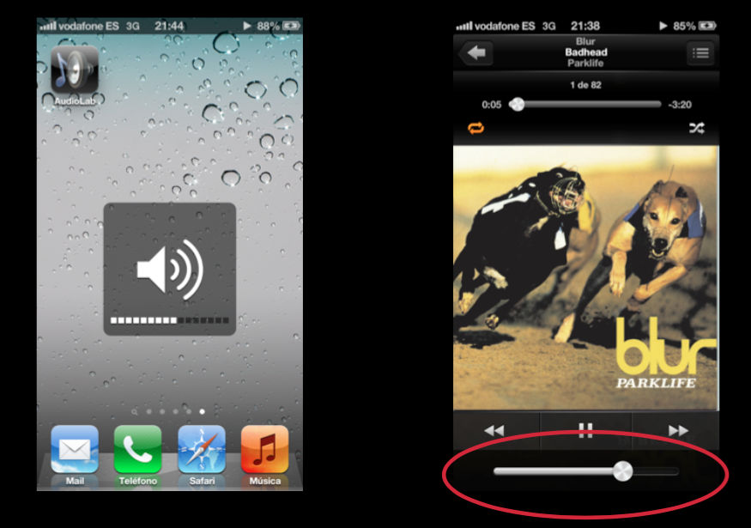
System Volume

Slide 20
System Volume
Use a volume view to present a slider for setting the system audio output volume, and a button for choosing the audio output route.
When first displayed, the slider’s position reflects the current system audio output volume.
Moving the slider OR pressing device volume buttons BOTH change in system volume.
If there is an AirPlay-enabled device in range, the route button allows the user to choose it.
// MPVolumeView is a subclass of UIView
MPVolumeView *myVolumeView = [[MPVolumeView alloc] initWithFrame: CGRectMake(20, 450, 280, 20)];
// so it can be added as a subView
[self.view addSubview: myVolumeView];

Slide 21
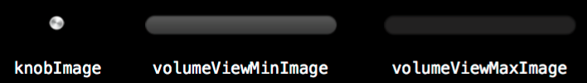

System Volume customization
// load in your custom images
UIImage* knobImage = ...
UIImage* minImage = ...
UIImage* maxImage = ...
// and assign them to your system volume slider
[myVolumeView setVolumeThumbImage: KnobImage];
[myVolumeView setMinimumVolumeSliderImage:minImage];
[myVolumeView setMaximumVolumeSliderImage:maxImage];
Can you make your volume button look like this?

Slide 22
Some Resources
https://ccrma.stanford.edu/~jsanchez/NSSpain.pdf
https://developer.apple.com/library/ios/documentation/MediaPlayer/Reference/MediaPlayer_Framework/
https://www.raywenderlich.com/36475/how-to-make-a-music-visualizer-in-ios

